Slide 1

FastAPI Fundamentals
Troulakis Emmanouil- Data Software Engineer

Slide 2
Context
What is API?
What is FastAPI?
Why FastAPI?
Type Hinting
Pydantic - Data Validation
Async Support and concurrency
SqlAlchemy - ORM
A FastAPI Application
Middleware
Handling Errors
Testing
Deployment
Useful Materials

Slide 3
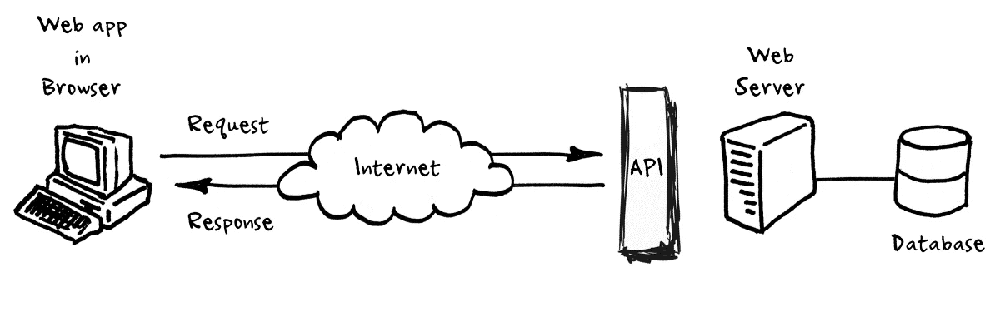
What is API ?
APIs (Application Programming Interfaces) are the digital bridges that connect software applications, allowing them to communicate, share data, and work together seamlessly. They empower developers to unlock new functionalities, integrate diverse systems, and drive innovation in the digital landscape.

Slide 4

What is FastAPI ?
FastAPI is a modern, fast (high-performance), web framework for building APIs with Python 3.7+ based on standard Python type hints. It is built on top of Starlette for the web parts and Pydantic for the data parts.

Slide 5
Why FastAPI ?
1. Starlette: a lightweight ASGI framework/toolkit, which is ideal for building high performance asyncio services.
2. Performance: As fast as NodeJS and Go, unusual for Python frameworks.
3. Faster Development: No sharp edges or oddities. Designed to be easy to use and learn.
4. Better code quality: Type hinting and models help reduce bugs and improve code quality.
5. Autogenerated Documentation and test pages: Much easier that hand-editing OpenAPI descriptions.
6. Asycronous support: Supports async and await, making it ideal for IO-bound operations.

Slide 6
Type Hinting
Type hinting is a feature that was added to Python 3.5. It allows you to specify the type of a variable, function argument, or return value. This makes it easier to understand and maintain your code.
Type hinting is purely optional in Python, meaning that the interpreter does not enforce the specified types at runtime. However, type hinting can be used by third-party tools such as type checkers (e.g., MyPy) and IDEs to perform static analysis and catch potential type-related errors early in the development process.

Slide 7
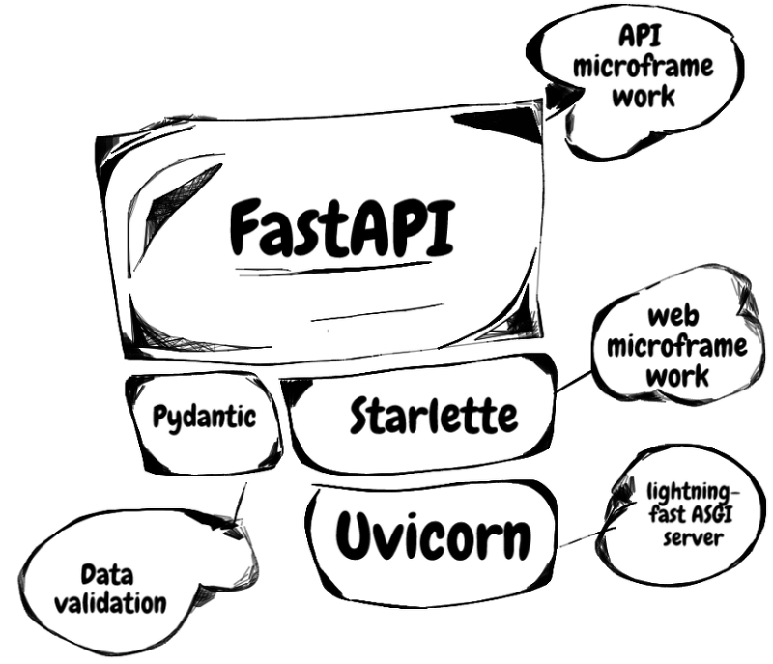
Pydantic - Data Validation
Pydantic is a library that was created to provide an easy and efficient way to define and validate data models in Python. It is built on top of the popular library dataclasses, and provides a number of additional features and benefits, such as:
1. Type Annotations: Define fields and their types for data models using type annotations.
2. Constraints and Defaults: Set constraints and default values for fields to ensure data integrity and completeness.
3. Serialization and Deserialization: Serialize and deserialize data models to various formats (e.g., JSON, YAML, XML) for easy data manipulation and exchange.
4. Data Validation: Automatically validate data models against their defined constraints and types.

Slide 8
Async Support and concurrency
FastAPI offers robust support for asynchronous programming and concurrency, enabling developers to build high-performance web APIs capable of handling multiple requests concurrently without blocking.
By leveraging asynchronous techniques, FastAPI maximizes throughput and responsiveness, facilitating efficient execution of I/O-bound operations and integration with async-compatible libraries for database access, background tasks, and middleware functions.
1. Async Support: FastAPI fully embraces asynchronous programming with async and await syntax.
2. Concurrent Request Handling: FastAPI efficiently handles multiple requests concurrently without blocking.
3. Async Database Access: Integration with async-compatible database libraries for non-blocking database queries.
4. Background Tasks: Ability to execute long-running tasks asynchronously outside of the main request-response cycle.
5. Async Middleware: Support for asynchronous middleware functions for request and response handling.

Slide 9
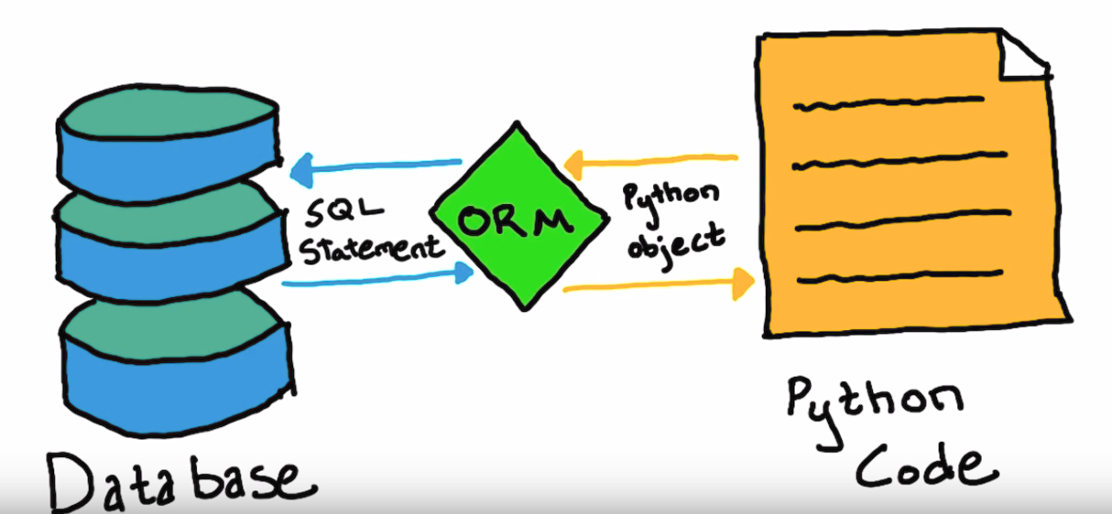
SqlAlchemy - ORM
SQLAlchemy is a popular Object-Relational Mapping (ORM) library for Python that provides a high-level interface for interacting with relational databases. It allows developers to define database models as Python classes, and perform database operations using an expressive and flexible API. FastAPI integrates seamlessly with SQLAlchemy, enabling developers to build web APIs that interact with databases using the powerful features of SQLAlchemy.

Slide 10
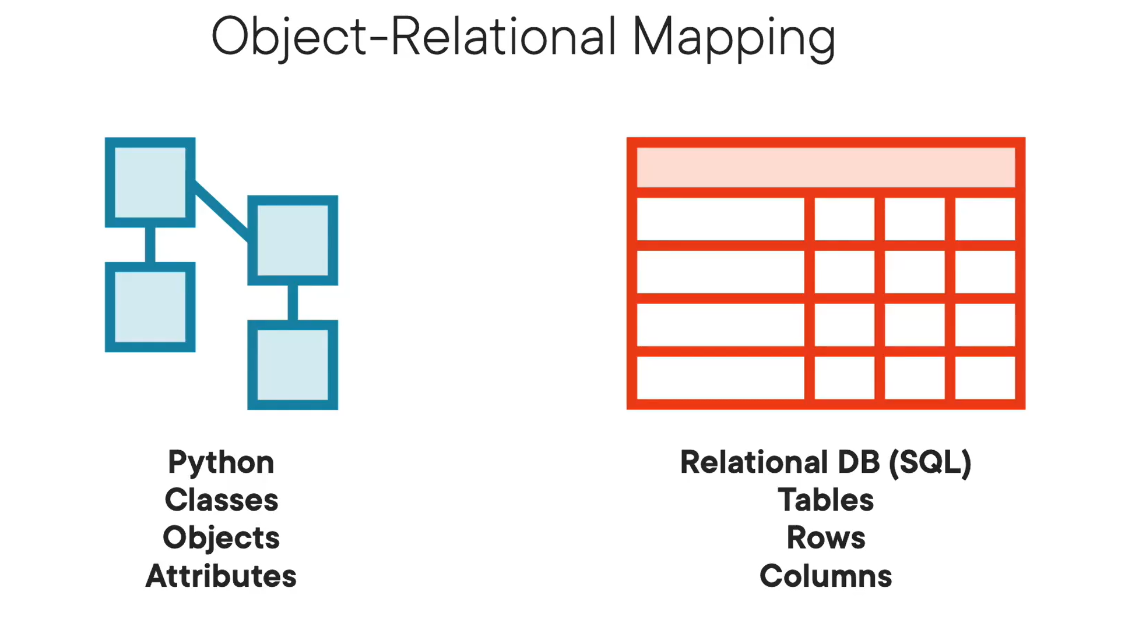

Slide 11
Pydantic vs SQLAlchemy
Pydantic:
Used for data validation and serialization/deserialization.
Ideal for validating and parsing data received from external sources like API requests (e.g., FastAPI endpoints).
Helps ensure that the incoming data adheres to a specified data schema (defined using Pydantic models).
Provides automatic type conversion and validation based on the defined data types and constraints in the models.
Useful for handling complex data structures and nested schemas.
SQLAlchemy:
Used for working with relational databases and performing ORM (Object-Relational Mapping) operations.
Ideal for building database-backed applications and interacting with SQL databases.
Allows defining database models as Python classes (SQLAlchemy models) that map to database tables.
Provides functionalities for querying, inserting, updating, and deleting data in the database using Python code (without writing raw SQL queries).
Supports relationships between tables, transactions, and various database operations.

Slide 12
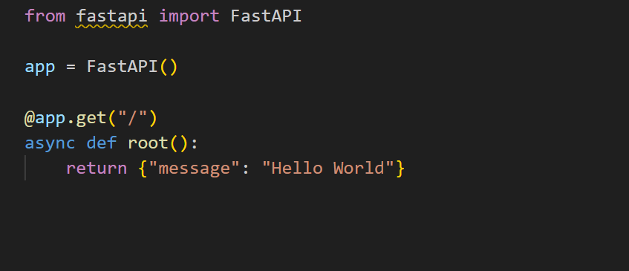
A FastAPI Application
Explanation of Code:
Import FastAPI library: from fastapi import FastAPI
Create an instance of FastAPI: app = FastAPI()
Define a GET endpoint at root ("/"): @app.get("/")
Define an asynchronous function root() to handle the GET request and return a JSON response: {"message": "Hello World"}
The command uvicorn main:app refers to:
main: the file main.py (the Python "module").
Unicorn: a Unix-based HTTP server for serving Python web applications.
app: the object created inside of main.py with the line app = FastAPI().
--reload: make the server restart after code changes.

Slide 13

HTTP Methods
GET: Used to retrieve data from a specified resource. For example, fetching a user's details or retrieving a list of items.
POST: Used to submit data to be processed to a specified resource. For example, creating a new user or sending form data to the server.
PUT: Used to update data on a specified resource. For example, updating an existing user's information.
DELETE: Used to delete a specified resource. For example, deleting a user or removing an item from a list.
PATCH: Used to partially update data on a specified resource. For example, updating only certain fields of an existing resource.
OPTIONS: Used to retrieve the supported HTTP methods for a resource. It's commonly used for Cross-Origin Resource Sharing (CORS) preflight requests.
HEAD: Similar to a GET request, but only retrieves the headers of a response without the actual data. It's often used to check the status of a resource without fetching its content.

Slide 14
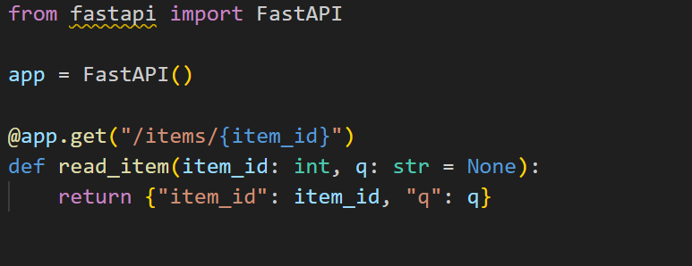
Path Parameters
Path parameters are a way to pass data or information to a web server or API endpoint through the URL path. In FastAPI, path parameters are defined within the route path using curly braces {}. When a request is made to the specified URL, FastAPI extracts the values from these path parameters and passes them to the corresponding endpoint function.

Slide 15
Request Body
Request Body:
Data sent from a client (e.g., a browser) to your API.
Enables structured information transfer for server-side processing.
Response Body:
Data sent by your API back to the client post-request processing.
Contains requested information or operation results from the API.

Slide 16
Handling Errors
Handling errors in FastAPI involves managing and responding to various types of errors that may occur during the processing of HTTP requests. FastAPI provides built-in mechanisms to handle errors gracefully and return appropriate responses to clients, improving the overall robustness and reliability of your API.
Exception Handling: Uses Python's try-except blocks to catch and handle errors during request processing.
HTTPException: FastAPI's HTTPException class raises HTTP-specific exceptions with customizable status codes and error messages.
Custom Error Handlers: Define custom error handler functions with app.exception_handler to catch specific exceptions.
Validation Errors: FastAPI automatically validates request data based on Pydantic models and raises validation errors for type mismatches or constraints.

Slide 17
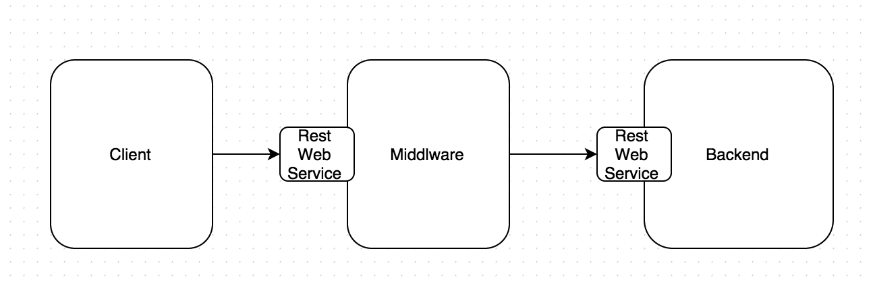
Middleware
A “middleware” is a function that operates on each request before it is processed by a specific path operation . And also with every response before it is returned.
It accepts every request that is sent to your application.
It can then do something with that request or execute arbitrary code.
It then passes the request on for processing by the rest of the application (through a specific path operation ).
It then accepts the response generated by the application (through a specific path operation ).
Then she returns the response .

Slide 18
Testing
Testing in FastAPI using TestClient is a powerful way to ensure that your API endpoints behave as expected under different scenarios. The TestClient provided by FastAPI's testing utilities allows you to simulate HTTP requests to your API and validate the responses, making it easier to perform automated testing and verify the correctness of your API implementation.

Slide 19
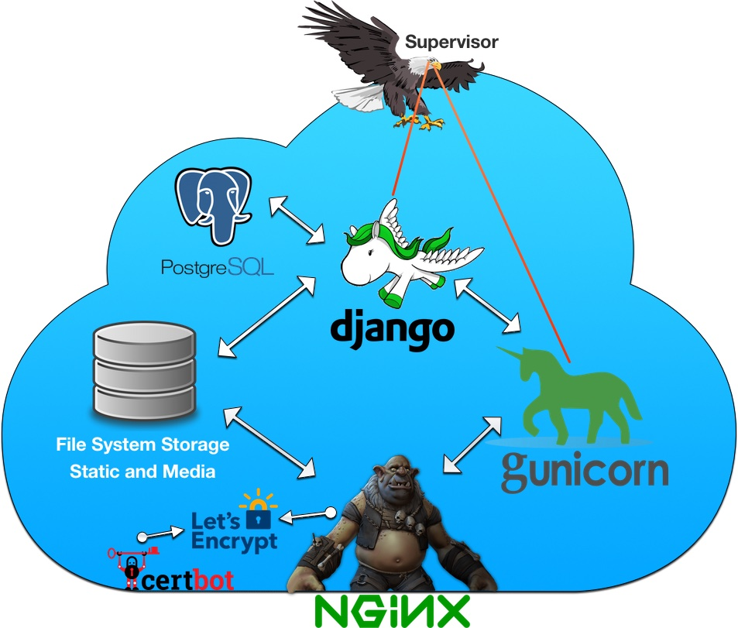
Deployment
To deploy an application means to perform the necessary steps to make it available to the users. For a web API, it normally involves putting it in a remote machine, with a server program that provides good performance, stability, etc, so that your users can access the application efficiently and without interruptions or problems.
Heroku: Easy-to-use cloud platform with a free tier for small projects.
AWS Elastic Beanstalk: Scalable deployment on AWS infrastructure with managed services.
Google Cloud Platform (GCP) App Engine: Managed platform for deploying and scaling applications.
Microsoft Azure App Service: Hosting for web applications and APIs with Azure's infrastructure.
Docker Containers: Containerize your FastAPI app for deployment on any container orchestration platform Serverless Deployment (AWS Lambda, Azure Functions, Google Cloud Functions)
Continuous Integration/Continuous Deployment (CI/CD) Tools: Use CI/CD pipelines with platforms like Jenkins, GitLab CI/CD, GitHub Actions to automate deployment processes.
This Photo by Unknown Author is licensed under CC BY-SA-NC

Slide 20
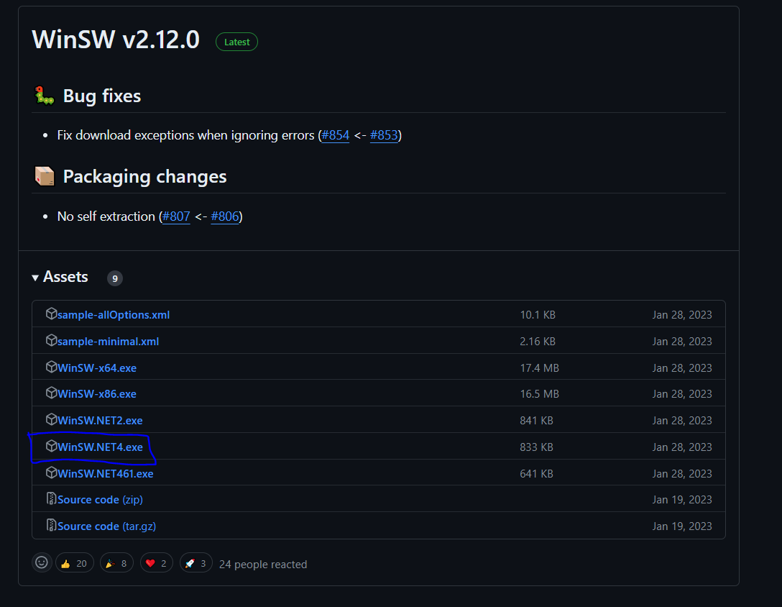
WinSW (Windows Service Wrapper)
The WinSW (Windows Service Wrapper) is a tool that allows you to run any executable as a Windows service. It provides a way to create and manage Windows services from executable files that are not specifically designed to run as services. WinSW simplifies the process of running applications in the background as services on Windows systems.
https://github.com/winsw/winsw/releases

Slide 21
XML
<service>
<id>FastAPI Demo</id>
<name>FastAPI Demo</name>
<description>FastAPI Demo.</description>
<executable>/path/to/your/virtual/environment/Scripts/python.exe</executable>
<arguments>/path/to/your/project/main.py</arguments>
<onfailure action="restart" delay="30 sec"/>
<onfailure action="restart" delay="40 sec"/>
<onfailure action="restart" delay="60 sec"/>
<log mode="roll-by-time">
<logpath>/path/to/your/project/Logs</logpath>
<pattern>yyyyMMdd</pattern>
<keepFiles>8</keepFiles>
</log>
</service>

Slide 22
Thank you!
POWERED BY AGILE ACTORS

